Slide 1

NFA Webinar:
A Deep Dive into FEMA’s Letters of Map Change
October 7, 2026
Presented by:
Jennifer Haun, ServiceLink National Flood
Gerry Evenwel, National Flood Experts
Derik Pierson, AFR Services, Inc.
Andy Yesaitis, Western Technologies Group, LLC

Slide 2
Letter of Map Amendments (MT-1 & eLOMA)
Andy Yesaitis

Slide 3

The Basics
Due to map scale limitations and source map topographic constraints, some small areas may be mistakenly shown within a Special Flood Hazard Area (SFHA). "inadvertent inclusions.“
In other cases, earthen fill may have been placed during construction, raising a portion of the property to an elevation at or above the BFE.
As a result, some areas that are at or above the BFE may be incorrectly included within the SFHA on the FIRM.
Recognizing that these situations do occur, FEMA established administrative procedures to change the designation for these properties on the FIRM. These processes are referred to as the Letter of Map Amendment (LOMA) process and the Letter of Map Revision-Based on Fill (LOMR-F) process.

Slide 4
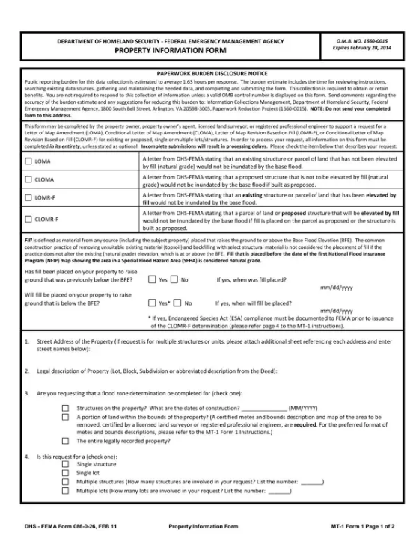


Standard MT-1 LOMA Application
REQUIREMENTS
MT-1 Form: Property Information Form
Annotated FIRMette: A to-scale map panel pinpointing the exact property and structure location relative to the SFHA.
Recorded Deed: Official subdivision plat or deed including the county recorder's stamp and legal description.
Elevation Data: Certified LAG usually in the form of an Elevation Certificate.

Slide 5
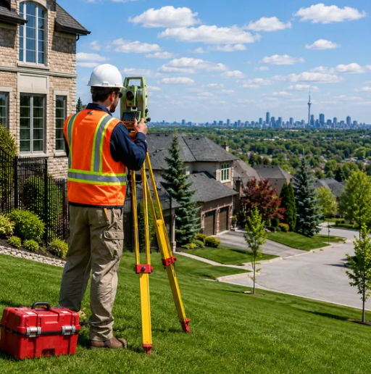
eLOMA Professional Workflow
1
Produce FIRMette
Map subject cross-section on official FIRMETTE.
2
Plot FIS Profile
Pinpoint location on FIS to establish precise BFE.
3
Analyze Elevations
Compare BFE against pertinent EC Section C2 (a,d,f,or h) elevations.
4
Execute eLOMA
Submit certified determination via MIP portal.

Slide 6
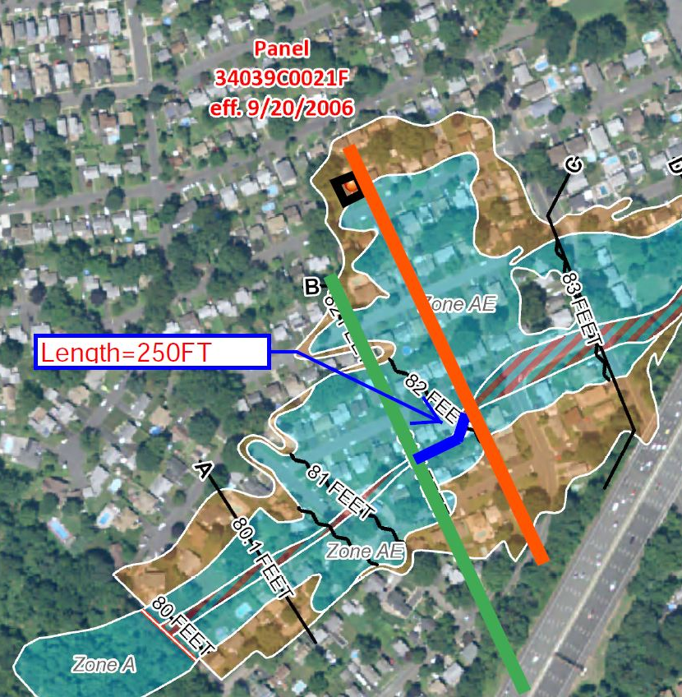
CASE STUDY: STEP 1 - FIRMETTE ANNOTATION
Cross-Section Interpolation
Ref: (Panel 3403900021F, Zone AE)
Subject Structure
Isolate physical footprint on map.
Subject Cross Section
Should be perpendicular to stream flow and at upstream most corner of the structure.
Known FEMA Cross Section
Anchor to published BFE (In this case cross section B).
Stream Distance
Measure distance between subject and known cross sections for profile plotting (here its 250ft).

Slide 7
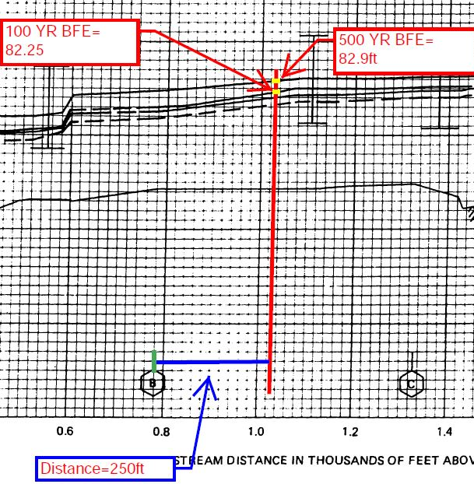

CASE STUDY: STEP 2 - FIS PROFILE ANNOTATION
FIS Profile BFE Extraction
Plotting the measured 250 FT distance to determine the precise 1% and 0.2% annual chance elevations.
Baseline Cross Section
Locate known Cross-Section B on x-axis.
Plot Distance
Measure 250 FT upstream along the x-axis grid.
Project Vertical
Draw subject cross section intersecting flood profiles for 1 and 0.2% annual chance.
Extract BFE
Read y-axis at intersection points (82.3 FT & 82.9 FT).

Slide 8
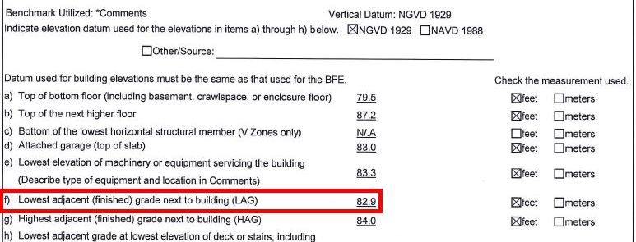

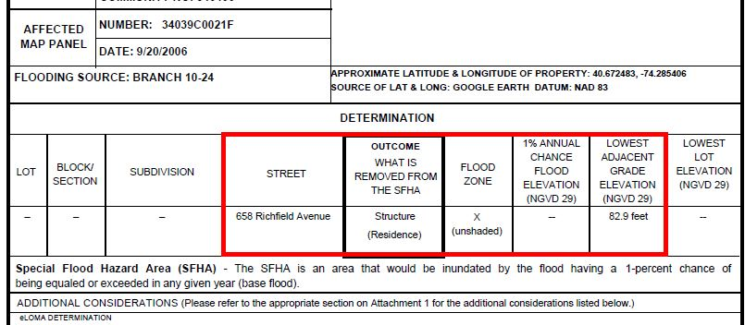

CASE STUDY: STEP 3 - FINAL DETERMINATION
The Eligibility Threshold
Comparing the FIS Base Flood Elevation against the certified Elevation Certificate data.
1. ELEVATION CERTIFICATE (SECTION C)
Exact BFE of structure
82.3 FT
CERTIFIED LAG (SECTION C2F)
82.9 FT
2. FINAL LOMA DETERMINATION DOCUMENT
Successful LOMA
82.9 FT (LAG) > 82.3 FT (BFE)

Slide 9
Letter of Map Revisions (MT-2)
Gerry Evenwel

Slide 10
Inside an MT-2 submission
A consistent record of the flood study, project effects and requested map change
Reference and field evidence
Engineering analysis
Submission record
Archives, surveyors and the design team
H&H engineers and GIS specialists
Certifiers, communities and FEMA review
Regulatory baseline
Existing Conditions and Study
Effective models and report
FIRM/FIS, prior revisions
and archived model files
Reproduce the baseline
Inputs, outputs, comparisons
and the reason for each change
Rainfall and flow data
Hydrology
Watershed response, losses,
flows and event frequencies
Estimate flow and runoff timing
Update Mapping and Evidence
Hydraulics
Workmaps, profiles, BFEs
and floodway limits as applicable
Topo and Geometry
Survey, datum, terrain,
channels and crossings
Resolve water levels and flow paths
Final Model and Packaging
Certifications and coordination
Project record
Forms, community acknowledgments
and required notices
Grading, structures, storage,
drawings and as-builts
Check effects and study tie-ins
Consistency checks
Vertical datum, design geometry, model comparisons, study limits and impact footprint
Additional modules as applicable: floodways, structures, coastal or levee analyses, and affected-party coordination
01
Notes:
An MT-2 case assembles technical evidence for a requested conditional or final revision. This diagram is a riverine example. Not every request uses every component shown, and some case types require additional modules.
The effective FIRM and Flood Insurance Study establish the regulatory reference. Prior map changes and available model files help reconstruct that reference. Survey and terrain data describe elevations, channels, structures and other hydraulic controls. Rainfall and flow information support the hydrologic analysis. Design drawings or as-built records supply the condition being evaluated.
Hydrology estimates the runoff or flows and, where relevant, their timing. Hydraulics represents their movement through the physical setting. The scenario comparison must explain what changed and how it affects water levels, floodplain or floodway delineation, and neighboring portions of the study.
The record includes model inputs and outputs, a report, comparison information, workmaps and the applicable certifications and community documentation. The formal requirements vary with the basis of the revision. Owner notice and public notice are not the same as an affected owner's consent. Acknowledgment and concurrence requirements for jurisdictions also depend on the case.
The green line illustrates a cross-dependency: changing project geometry must be reflected in the hydraulic representation. A survey datum discrepancy can propagate through the model and map. Changes to the impact footprint may require renewed community coordination or notices. These dependencies are the reason an application must be reviewed as a coherent engineering record.
Sources:
44 CFR 65.6, Revision of base flood elevation determinations: https://www.ecfr.gov/current/title-44/chapter-I/subchapter-B/part-65/section-65.6
44 CFR 65.7, Floodway revisions: https://www.ecfr.gov/current/title-44/chapter-I/subchapter-B/part-65/section-65.7
44 CFR 65.12, requirements for qualifying proposed encroachments: https://www.ecfr.gov/current/title-44/chapter-I/subchapter-B/part-65/section-65.12
National Flood Experts: NFE Stormwater Presentation - slides 13, 20 and 22 and their notes.

Slide 11

The MT-2 model sequence
Each comparison separates model corrections, site changes and project effects.
01
02
03
04
05
06
Effective
Duplicate
Effective
Corrected
Effective
Existing
Proposed
As-built
Use the study behind
the effective map
Rerun the original
model inputs
Fix documented
model errors
Represent current
preproject conditions
Evaluate the
project’s effect
Model what was
actually built
if needed
if constructed
Existing vs. proposed isolates the project’s effect.
Typical sequence. The available study and project determine the required models.
02
Notes:
A typical model lineage gives the reviewer a traceable explanation of why results change. The six stages distinguish the study of record, its reproduction, justified corrections, current preproject conditions, the proposed project and actual construction when applicable.
1. Effective: Begin with the effective study and the model supporting the regulatory map.
2. Duplicate Effective: Rerun the effective model using unchanged inputs. Document any numerical differences, including those associated with software versions.
3. Corrected Effective, if needed: Make and document justified corrections to errors in the original model. This stage is separate from physical changes on the ground.
4. Existing: Represent current preproject physical conditions and justified model refinements, including additional cross sections when needed.
5. Proposed: Introduce the project change using a comparable model setup. Compare existing and proposed results to evaluate the project's effect on water-surface elevations and the surrounding study area. Carry common non-project refinements into both models so they do not become confused with the project effect.
6. As-built, if constructed: Incorporate surveyed final grades and actual structure geometry, reconcile the completed work with the proposed condition and evaluate final results for the revision package.
This is a typical sequence, not six universally required models. An unavailable or unsuitable effective model may require a supported alternative analytical basis. An approximate Zone A may require a new detailed study. Some studies revise hazards without a construction project. Where relevant, analysis must address floodplain and floodway changes and tie-ins to unaffected study reaches.
The visual aids are conceptual illustrations. The river scenes do not represent a real site, model output, computed water-level change or flood extent. The check beside the last scene indicates verification of constructed conditions, not FEMA approval.
Sources:
44 CFR 65.6, supporting analysis and study tie-ins: https://www.ecfr.gov/current/title-44/chapter-I/subchapter-B/part-65/section-65.6
National Flood Experts: NFE Stormwater Presentation - slide 13 and speaker notes for the model sequence, slide 15 and notes for consistent comparisons, and slide 22 and notes for as-built analysis.

Slide 12
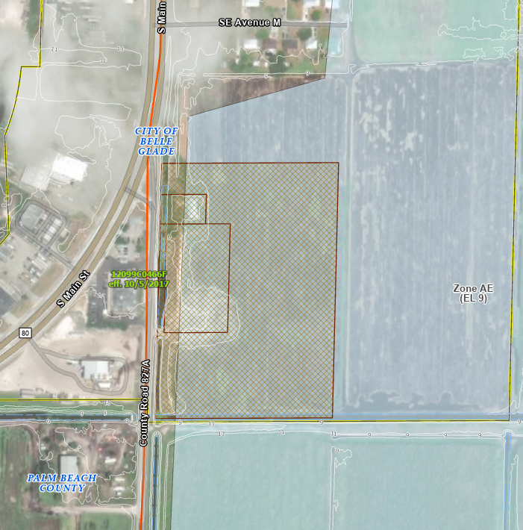
The study extends beyond the parcel
Belle Glade, Florida: proposed fill, stormwater storage and a wider hydraulic system
Site and effective-map context
~15 acres
3–4 feet
~11 acre-feet
development area
proposed fill
wet pond
Case condition | Engineering response
Effective model unavailable | Develop and justify an alternative analytical baseline
Flat terrain and canals | HEC-RAS 2D rain-on-grid: rainfall, infiltration and shallow overland flow
Fill and stormwater storage | Compare existing and proposed conditions, including the response beyond the site
City–County boundary | Extend the study and coordinate with both communities
The modeled domain extends beyond this view
into the City and surrounding agricultural fields.
03
Notes:
This case is under review as stated in the supplied September 21, 2026 stormwater presentation. No approved CLOMR or completed LOMR outcome is asserted.
The proposed residential development covers approximately 15 acres in Zone AE in Belle Glade, Palm Beach County, Florida. The supplied narrative describes 3–4 feet of structural fill and an 11 acre-foot wet pond. Average site grade would rise from approximately 8.3 to 12.0 feet. The slide uses the rounded fill range rather than relying on an unstated vertical datum for those grades.
The effective hydraulic model could not be obtained despite the effective map's 2017 date. The team developed an alternative analytical basis. Flat terrain and the surrounding canal system supported using HEC-RAS 2D rain-on-grid to represent direct rainfall, infiltration, shallow overland flow and canals. The absence of the original model does not, by itself, dictate a specific alternative method. Method selection must fit the physical setting and supporting evidence.
The model extended beyond the development into the City and agricultural fields. The case involved coordination with the City of Belle Glade and Palm Beach County. The supplied notes describe the need for MT-2 Form 1 involvement by both communities.
The source image is a site/effective-map context image. It is not a model-domain map or a computed change-in-water-level map. No new model boundary, flow direction or affected-property polygon has been added. The geographical point is the scope described in the case narrative.
The proposed storage and raised ground are evaluated as parts of a connected system. Neither the pond volume nor the fill height alone demonstrates the surrounding hydraulic response.
National Flood Experts: NFE Stormwater Presentation - slide 20, its map image and speaker notes.

Slide 13
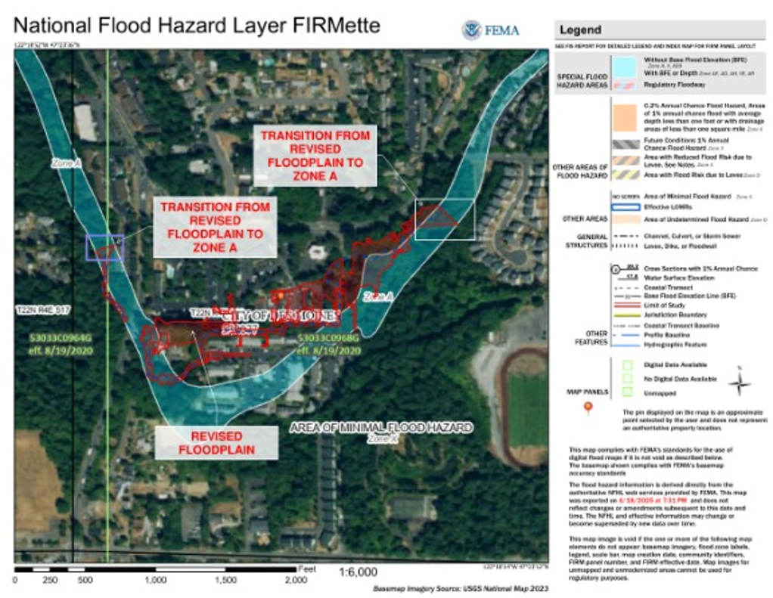
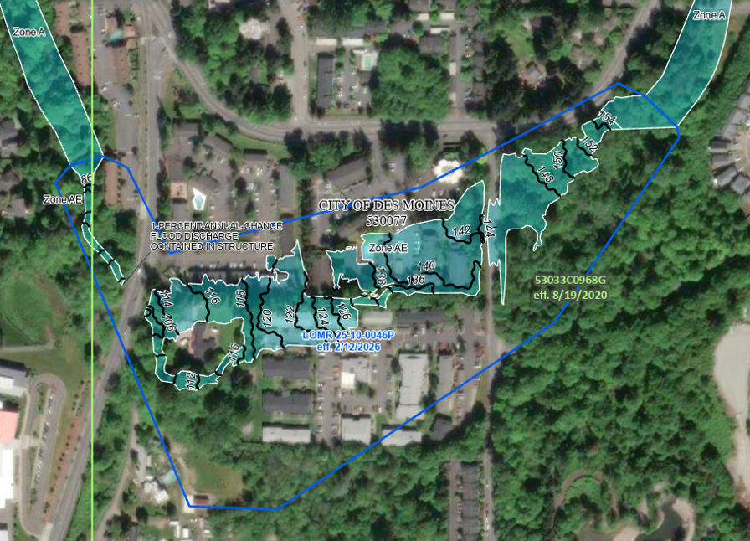
What a completed revision delivers
Massey Creek, Des Moines, Washington
Earlier Zone A with study overlay
Effective Zone AE with BFEs
THE PROBLEM
MODELING APPROACH
OUTCOME
Effective Zone A mapping did not follow the actual Massey Creek thalweg; no published flood discharges or BFEs.
Hydrologic analysis developed the 1% annual-chance flood discharges. HEC-RAS 2D defined the flood path and BFEs.
FEMA-approved Zone AE mapping with BFEs. LOMR 25-10-0046P became effective February 12, 2026.
05
Notes:
Massey Creek is the completed-result example. The supplied case describes approximate Zone A mapping with no published base flood elevations or flood discharges and a boundary that did not follow the channel well. The team developed 1% annual-chance discharges through hydrologic analysis and used HEC-RAS 2D to define the flood path and BFEs.
The supplied map identifies LOMR 25-10-0046P, effective February 12, 2026, and shows Zone AE with BFEs in the revised reach. Portions outside the detailed revision remain Zone A. The underlying FIRM panel label still shows its earlier panel date; the LOMR identifies the subsequent revision and effective date.
The earlier source map includes the red revision-study overlay. It is identified on the slide rather than presented as a clean, unannotated before map. The two source images have been cropped to approximately the same reach, using common visible features, without changing their mapped information. This is a visual comparison, not a georeferenced area calculation. No acreage reduction is asserted.
The result has several components. Engineering findings establish discharges and elevations. The spatial product defines the flood path, boundaries and BFEs. The regulatory record identifies the issued revision, its geographic scope and its effective date. Engineers can use the analytical record, communities can administer the applicable requirements, and determination professionals can identify and apply the effective mapping information.
Distinguish what changed in the analysis, what changed physically, and what changed in the regulatory record. This example demonstrates improved flood-hazard definition. A map change alone does not establish physical risk reduction or elimination of residual flood risk.
National Flood Experts: NFE Stormwater Presentation - slide 23, its speaker notes and both map images.

Slide 14
Lender Compliance and the NFIP
Derik Pierson
Gerry Evenwel

Slide 15
Lender Compliance:
The SFHDF is a compliance document for the lender, and the regulations are very clear that it must be based solely on the effective FEMA map, or the latest effective revision to the FEMA map.
A property or structure-specific LOMA may be superseded by a subsequent LOMR or map panel revision.
An EC alone is not sufficient to overturn a FZD.
A LOMR is not valid until the Effective Date.
A CLOMR cannot be used to revise a FZD.
Typical turnaround time for a traditional online LOMC is 30-60 days after the application is submitted.
eLOMAs completed by a licensed surveyor, engineer, or certified professional may be completed in 5-10 business days.

Slide 16

How Risk Rating 2.0 Works
NFIP flood insurance pricing since October 2021
1
Two questions, two tools
2
Five perils, priced separately
3
One chain of multipliers
Base rate, per peril
THE MAP ASKS
In the 1% floodplain?
Sets the zone and whether insurance is required.
Inland flood everywhere
Storm surge coasts (zero on the West Coast)
Coastal erosion within 100 m of shore
Tsunami West Coast, Alaska, Hawaii
Great Lakes lakeshores
×
Where it sits
×
How it’s built
×
THE RATE ASKS
What does the risk cost?
Prices every building. The zone is not used.
How it’s insured
=
Each peril has its own base rate. They add up.
Add RCV/Coverage = premium
Takeaway: the zone says whether insurance is required. The chain sets the price.

Slide 17
Reading the Factors
1
Where it sits
2
How it’s built and insured
3
Discounts and limits
×1.00 = neutral
CRS DISCOUNT
Up to 45%
lowers
raises
First-floor height higher = lower
Foundation basement = higher
Floors and equipment both rated
Cost to rebuild scales the premium
Deductible higher = lower
Distance to river closer = higher
Elevation above river higher = lower
Relative elevation sits low = higher
Drainage area bigger = higher
Sub-watershed (HUC12) local adjustment
Coast distance, elevation, barrier island
MAXIMUM RATE
$15 per $1,000 (× ITV)
ANNUAL INCREASE
18% max for most
ELEVATION CERTIFICATE
Optional. Can lower the rate.
Under the cap = fully risk-based.
Plus statutory fees and surcharges.

Slide 18
Camp Mystic: Map vs. Rate
Kerr County, TX · July 4, 2025 · three cabins rated in Flocom under NFIP Risk Rating 2.0
Bottom line: Risk Rating 2.0 priced these cabins like the high-risk structures they were: about $6,000 a year each. After the LOMAs, the flood map no longer required anyone to buy the policy that carried that price (or signal).
1
The map and the rate answer different questions
2
The LOMA was correct. It didn't matter
3
The rating saw the risk
THE MAP SAID
Out of the floodplain
2013 LOMA: floors sit above the 1% flood level, so no one had to buy flood insurance.
Floors cleared the 1% flood by 9 ft. The July 4 flood ran about 15 ft above it.
Flocom’s factors, straight from FEMA’s Risk Rating 2.0 tables. ×1.00 = neutral.
July 4 water ≈1,851 ft
~6 ft over the cabin floor
Drainage area
223 km²
×1.64
Bubble Inn floor 1,845 ft
9 ft above BFE → LOMA granted
Relative elevation
51–63 ft below · table max
×1.54
Sub-watershed (HUC12)
top 20% of ~102,000 nationally
×1.41
THE RATE SAID
$6,012 – $6,387 a year
Appx. 5× the median NFIP full-risk premium.
BFE (1% flood) 1,836 ft
Distance to river
84–154 m · 84 m = table max
×1.02–1.08
Elevation above river
19–22 ft, Class C · table min
×0.36
Net geographic loading
Flocom “Inland Flood – Peril”
×1.31–1.40
River, normal 1,821 ft
Building rate $3.80–$5.87 per $1,000 of value vs. the cap of $15 × ITV = $11.79–$13.28: 32–44% of cap. Not capped, so fully risk-based.
Takeaway: pull the Risk Rating 2.0 quote for any property that matters. It's available with or without a policy, and it says more about the risk than the zone letter does.
Sources: Flocom RR2.0 ratings 1713 / 23181 / 23182; FEMA RR2.0 Appendix D factor tables (V2023_01) via the NFE reference-model package v0.1; Milliman, Risk Rating 2.0 Methodology and Data Sources (2021); FEMA LOMA records via News 4 San Antonio; AP/NPR (July 12, 2025); Sharif & Bose, Frontiers in Water (July 2026); GAO-23-105977 (median NFIP full-risk premium $1,288, Dec 2022). Factors are the Appendix D table values Flocom applied; the rate cap is $15 per $1,000 of building value × the deductible/ITV factor. July 4 water level is an estimate from the Hunt gauge rise and DEM elevations, not a surveyed high-water mark.
Notes:
Talking points
1) Different questions. The FIRM asks: is the floor above the 1% flood level? That drives mandatory purchase and floodplain rules. Risk Rating 2.0 asks: what does the risk cost? It does not use the zone at all — it uses distance to river (84–154 m here), elevation above river (~19–22 ft), relative elevation (the cabins sit 51–63 ft below the surrounding terrain), drainage area (223 km²), first-floor height (1.3–1.8 ft), foundation and replacement cost. Result: $6,012–$6,387 a year per cabin on $500K/$100K limits.
2) The LOMA was right and irrelevant. FEMA's 2013 amendment removed 15 Guadalupe-site buildings because their floors were above the BFE (Bubble Inn floor 1,845 ft vs. BFE 1,836 ft). The Hunt gauge rose from 7.6 ft to 37.52 ft; added to the 1,821 ft river elevation in the Flocom data, the July 4 water surface was roughly 1,851 ft — about 15 ft above BFE and 6–10 ft over the cabin floors. Independent reconstructions put the South Fork discharge near a 1-in-250-year event. A LOMA is a statement about the 1% flood, not the tail.
3) Signal never delivered. LOMA → no mandatory purchase → no policy → no RR2.0 quote → no price signal. Kerr County had about 466 NFIP contracts against 21,349 residential structures (Neptune Flood via Triple-I).
Why the rate is credible: Milliman built RR2.0 on three commercial cat models calibrated to 26 years of NFIP claims, GLM-fitted factors, HUC12 territories, and documented it against ten ASOPs; GAO (2023) found it improved actuarial soundness. Notably, Milliman deliberately gave LESS credit for elevation above river than the models indicated — the conservatism cut the right way here. Within-site premium spread is only 6%: location dominates.
Caveats: Bubble Inn is coded as a basement in the file (1.30 factor), almost certainly a data-entry issue; corrected to slab it would price ~$1,352.46 lower (decreased premium). A rate is an expected-value estimate, not a forecast of which year the tail arrives, and it carries no life-safety content.

Slide 19
Case Studies
Derik Pierson
Gerry Evenwel
Jennifer Haun
Andy Yesaitis

Slide 20
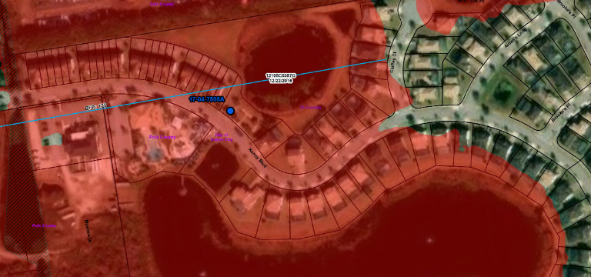

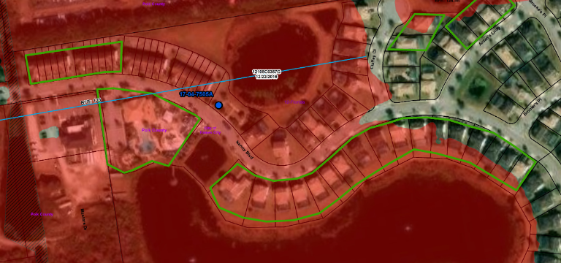
SPATIAL SCOPE
Map Points vs. Reality
A single NFHL point can represent a multi-structure determination.
1. Lat/Long Point
The Map Marker
The blue dot merely flags the existence of a LOMA record.
The Actual Scope
The determination document dictates the true spatial coverage.
2. Actual Multi-Structure Coverage

Slide 21
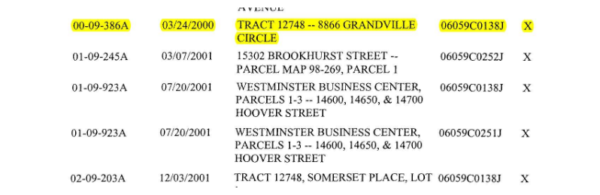

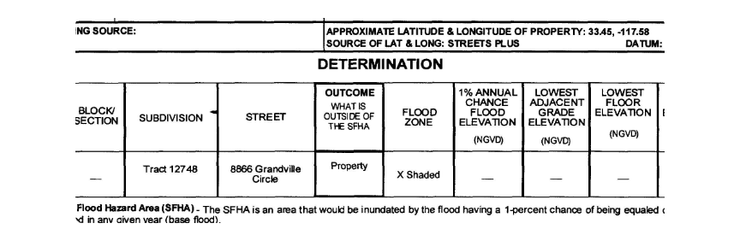

CASE STUDY: INVALID REVALIDATION
The Missing Data Error
Why this specific "Out As Shown" determination was revalidated in error.
1. REVALIDATION LETTER (EXCERPT)
The Error
OAS erroneously included in official revalidation list.
The Evidence
Original LOMA table contains zero elevation data.
2. ORIGINAL LOMA-OAS (BLANK ELEVATIONS)
The Verdict
Cannot mathematically verify LAG exceeds BFE.

Slide 22
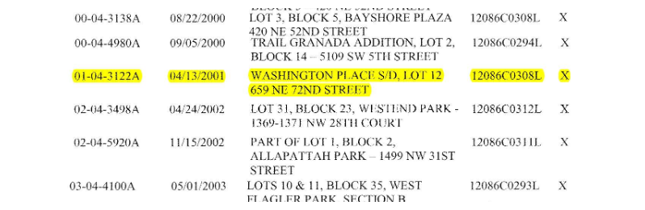
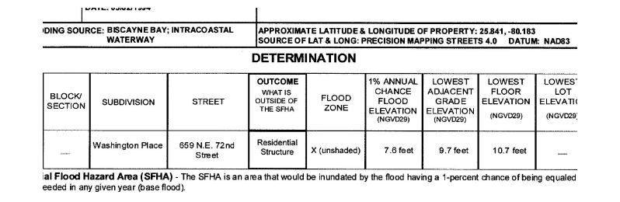

CASE STUDY: OAS REVALIDATION
Validating an OAS LOMA
Why this specific "Out As Shown" determination qualifies for official revalidation.
1. REVALIDATION LETTER (EXCERPT)
The General Rule
Standard OAS determinations lack necessary topographic data.
The Exception
2. ORIGINAL LOMA-OAS (EXCERPT)
Original LOMA table explicitly logs BFE (7.6 FT) and LAG (9.7 FT).
The Verification
Recorded LAG mathematically exceeds the 1% chance BFE.

Slide 23
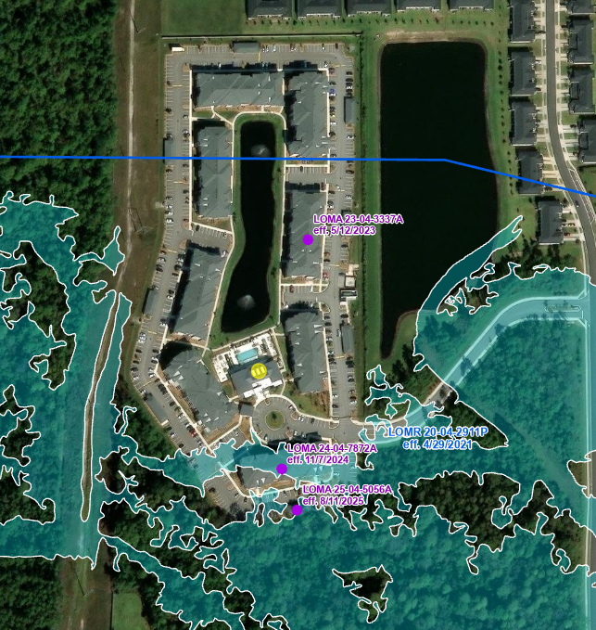
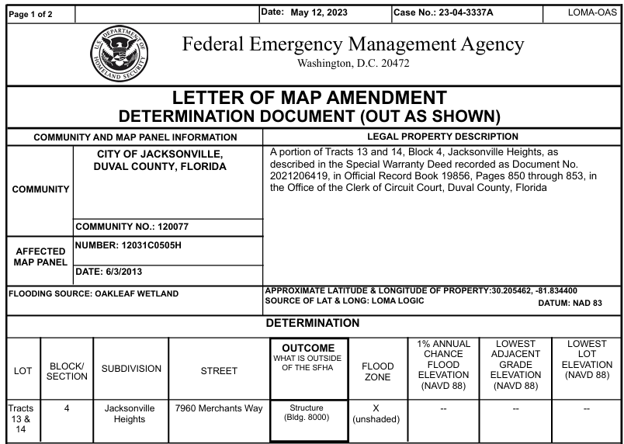
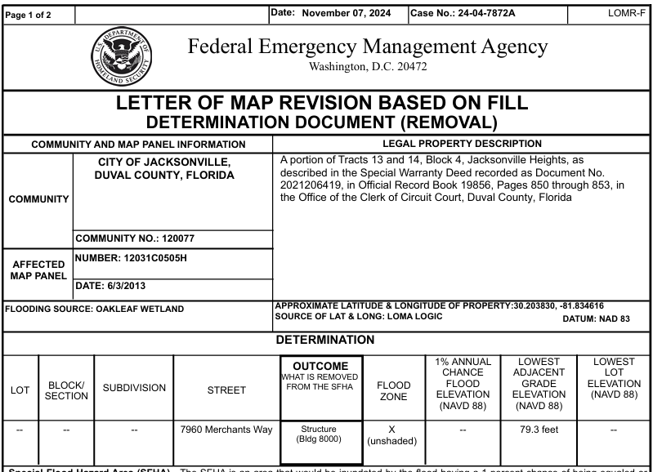

Slide 24
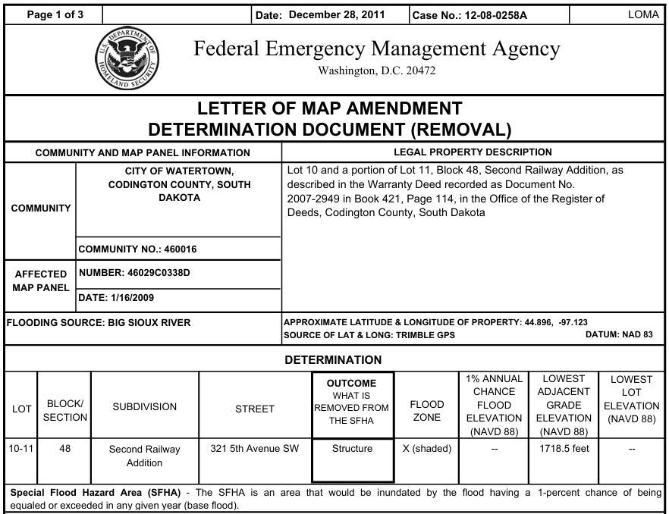
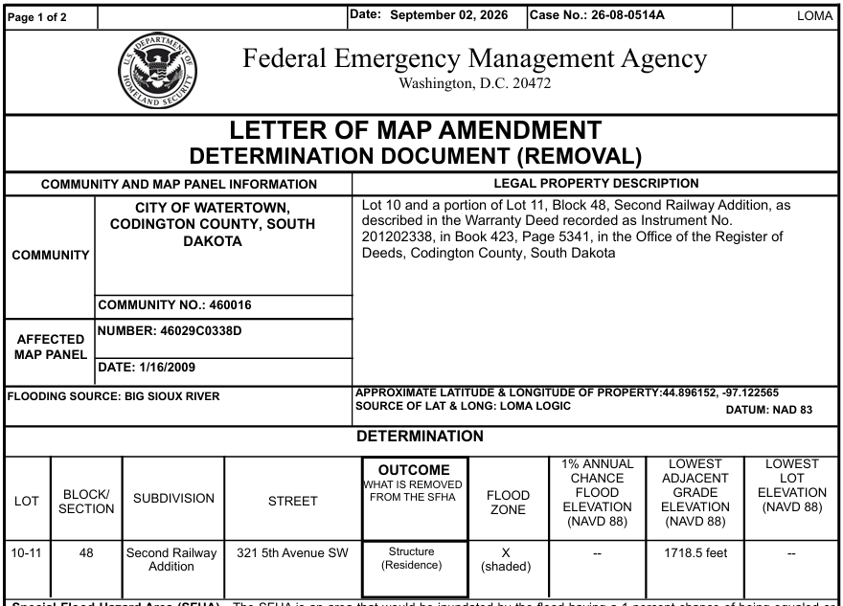
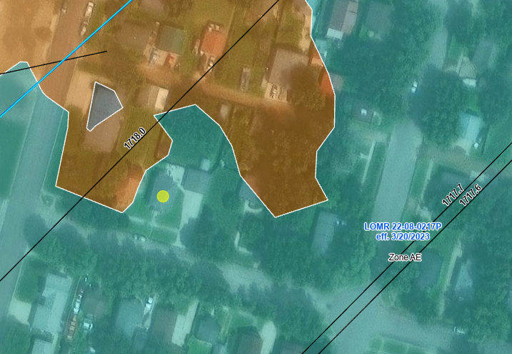
LOMC’s: Always use the newest date!

Slide 25

Questions?
If you’re a Certified Floodplain Manager (CFM) interested in earning 1 CE Credit for attending this webinar, please sign up for your certificate by scanning the QR code (requires Google app) or clicking the link in the Chat.

Slide 26
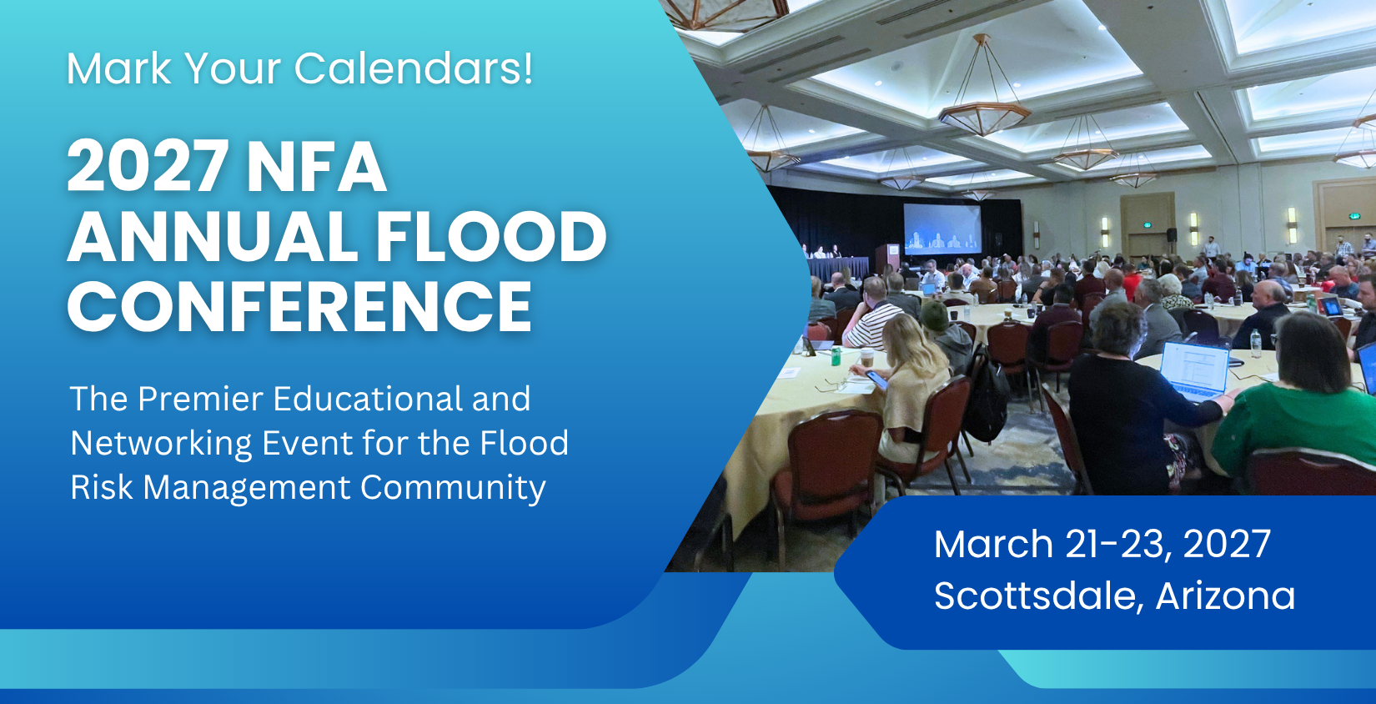
www.NFAflood.com

